Slide 1
SQL presentation

Slide 2
Objective
To analyze one year of retail sales data using SQL.
To design and create a structured sales database with appropriate tables and keys.
To answer key business questions on revenue, returns, sales trends, and customer behavior.
Engaging the audience
To validate and summarize data that supports business decision-making and dashboard development.

Slide 3
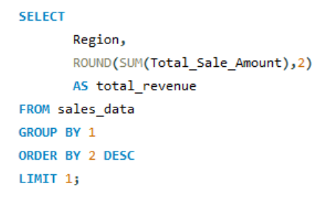

1. Which region has the highest total revenue?
RESULT

Slide 4
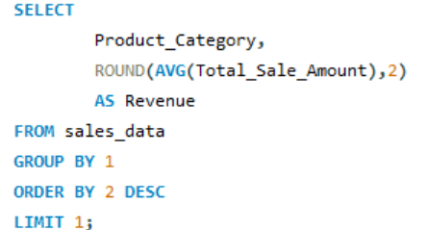

2. Which product category generates the highest revenue on average per sale?
RESULT

Slide 5
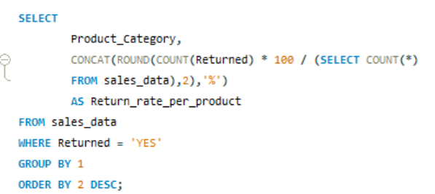
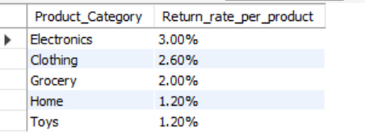
3. What is the return rate per product category?
RESULT

Slide 6
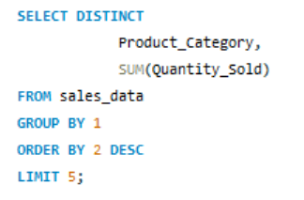
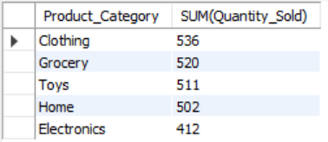
4. Identify the top 5 products with the highest total sales by quantity.
RESULT

Slide 7
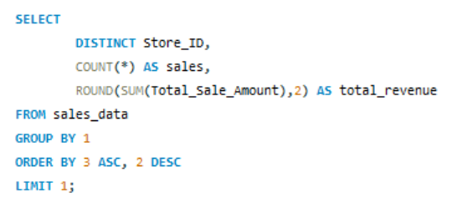

5. Which store has the lowest revenue but highest number of sales?
RESULT

Slide 8
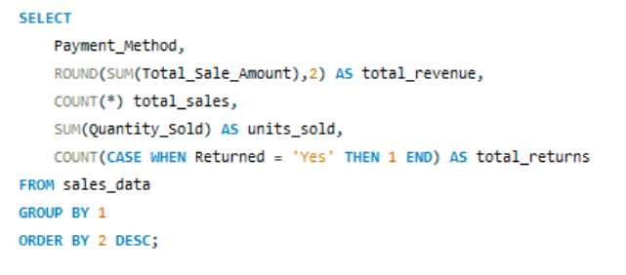
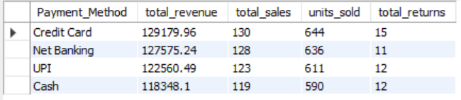
6. How do different payment methods impact total revenue?
RESULT

Slide 9
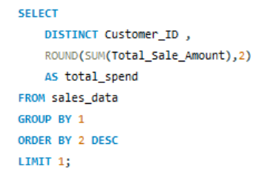

7. Which customers have made the most purchases in terms of total amount spent?
RESULT

Slide 10
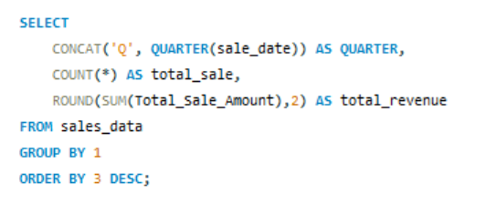
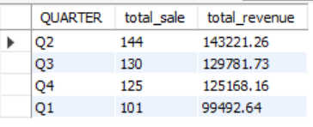
8. Which quarter sees the highest sales?
RESULT

Slide 11
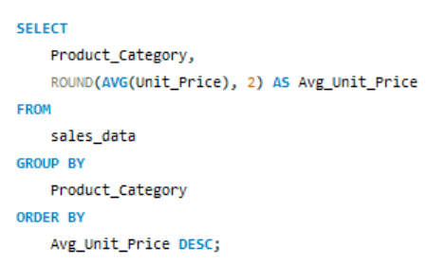
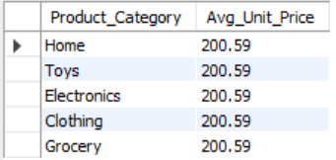
9. What is the average unit price per product category?
RESULT

Slide 12
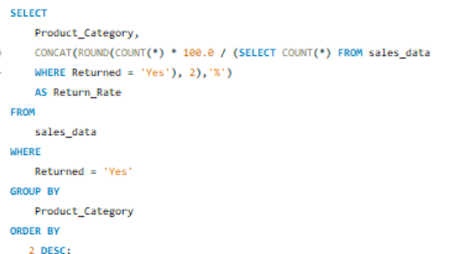
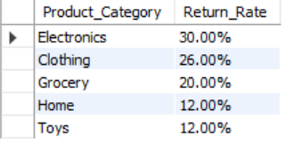
10. Which product categories have the highest return percentage?
RESULT

Slide 13
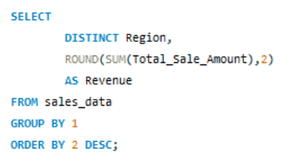
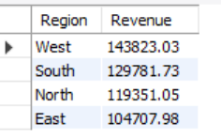
11. Total Revenue by Region
RESULT

Slide 14
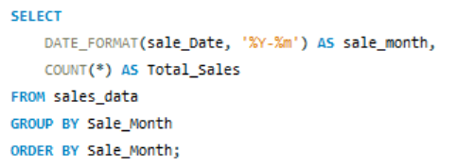
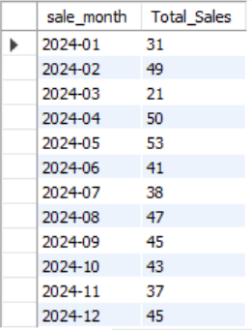
12. How did sales perform over each month?
RESULT

Slide 15
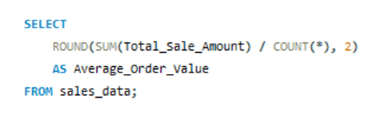

13. What is the average revenue per sale?
RESULT

Slide 16
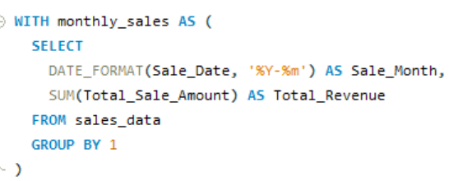
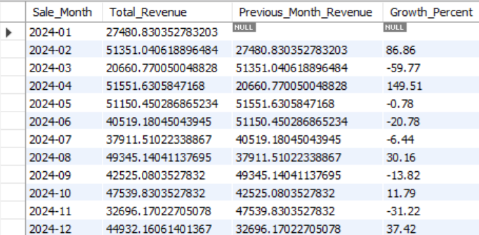
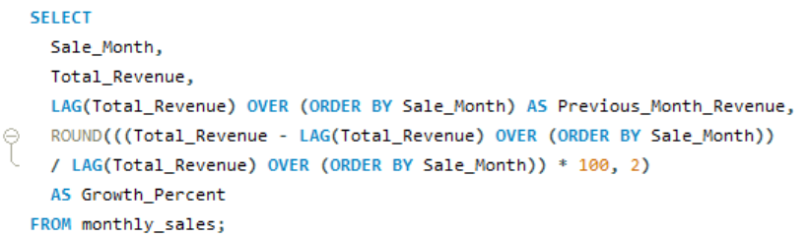
14. How is the sales growth trending month by month?
RESULT

Slide 17
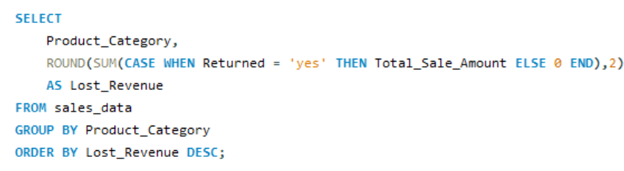
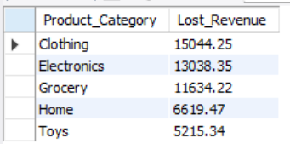
15. How much revenue was lost due to returned items?
RESULT

Slide 18
Thank you
ASADUZZAMAN SAFI
asaduzzamansafi@gmail.com

